Slide 1
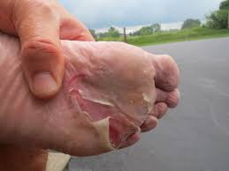
Blisters- The enemy of the feet
Most common medical problem (26-76%)
Most common reason to seek medical advice (33%)
Cause:
pain, poor performance, race withdrawal, infection, reduced nutritional intake
Prevention important!

Slide 2
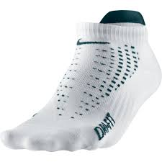
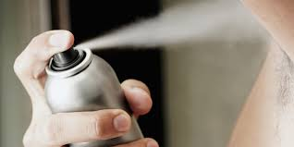
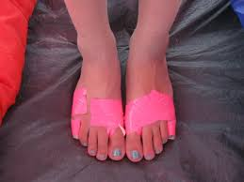
Blisters- The enemy of the feet
Prophylactic measures need to be investigated:
type and fabric of socks
tape
application of antiperspirants
talcum powder
lubricant

